Slide 1
Operating Systems
Chapter 2
Operating System Structures
What services an OS provides?
How services are provided?
What methodologies are for designing OS?
Spring, 2023
동국대학교 컴퓨터공학과 이 강 우 교수

Slide 2
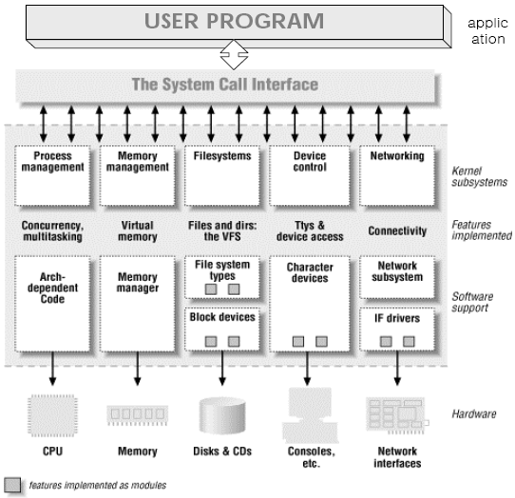
Subjects in Chap. 02
[2]
❍ Operating System Structures & Services
➢ OS Services = OS Rolls = OS functions
❍ User Operating System Interface
➢ GUI or CLI(Command Line Interpreter)
❍ System Calls
➢ Types of System Calls
➢ System Programs
❍ Operating System Design and Implementation
➢ Operating System Structure
➢ Operating System Debugging
➢ Operating System Generation
동국대학교 컴퓨터공학과 이 강 우 교수

Slide 3
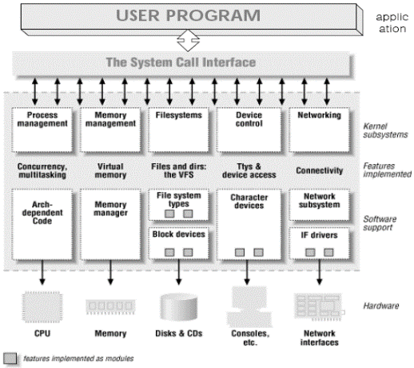
OS Services
❑ Two Goals of OS
1. User Convenience ← → Constraints
➢ Provide fancy environment (= interfaces) for …
⇦ Services to users & programs
 Running Programs (on CPU)
 File Manipulations (in Disks. Copy, Delete, …)
 and much more!!
2. System Efficiency ← → Constraints
➢ These are not visible to you!!
 CPU Management : CPU allocation & deallocation → Scheduling
 Memory Management : Space allocation & deallocation
 HDD Management : Space allocation & deallocation
 and much more!!
➢ Performed as its own algorithms and policies based on its goals
동국대학교 컴퓨터공학과 이 강 우 교수

Slide 4
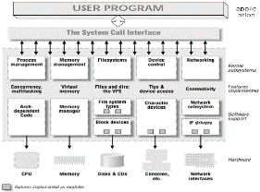
OS Services First Set of Services
One set of examples of OS services provide…
functions that present convenience to users:
❑ User interface … for user convenience ⇨ Not a Kernel
    ❍ Various types of UI are available
➢ Graphics User Interface (GUI) vs. Command-Line Interpreter (CLI)
❑ Program execution ⇨ CPU Mgt. + Memory Mgt. + HDD Mgt.
❍ to load a program into memory and
❍ to run that program,
❍ to end execution, normally(=terminate) or abnormally(=abort)
❑ I/O operations ⇨ CPU Mgt + (Block or Character) Device Mgt.
❍ A process may require I/Os involving files (in disks) or devices
❑ File-system manipulation ⇨ File Mgt. (= HDD Mgt.)
❍ Read or write files or directories according to permissions
❍ Create, delete, search, list them
동국대학교 컴퓨터공학과 이 강 우 교수

Slide 5
OS Services First Set of Services(Cont’d)
❑ Communications ⇨ Process(CPU) Mgt. & Network Mgt.
    ❍ Processes may exchange information(Data) …
➢ on the same computer, or ⇨ Process(CPU) Mgt.
➢ between computers over networks ⇨ Network Mgt.
❑ Error detection (⇨ actually, the 3rd Set of Services)
❍ OS has to be constantly aware of possible errors
❍ Errors may occur in CPU, memory, I/O devices(HDD), user programs
❍ For each type of error,
➢ OS should take appropriate actions ⇦ interrupt
➢ to ensure correct operations of computer system
❍ Debugging facilities are essential
➢ to greatly enhance user’s and programmer’s abilities
동국대학교 컴퓨터공학과 이 강 우 교수

Slide 6
OS Services Second Set of Services
Another set of example invisible OS functions exists for
ensuring efficiency of the system
via resource sharing in multiprogramming or multitasking
❑ Resource allocation
    ❍ CPU, Memory, HDD & Devices : Done by some routines in OS
❍ I/O Devices : Done by General Request-Release Codes
❑ Accounting
❍ to know which users use how much / what kinds of resources
❑ Protection and security (⇨ actually, the 3rd Set of Services)
❍ Every user wants to keep their own information safe
❍ Protection ensures all accesses to resources are controlled
❍ Security ensures user authentication from outside
동국대학교 컴퓨터공학과 이 강 우 교수

Slide 7
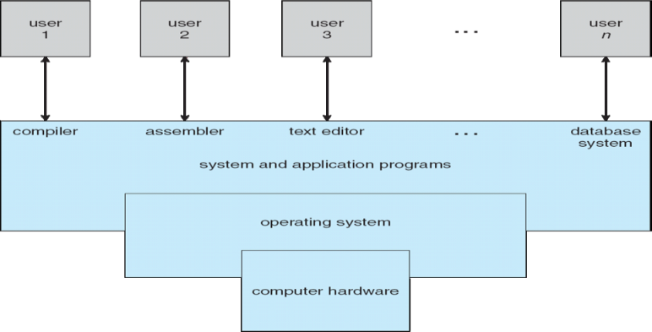

A View OS Services
[2]
OS
[1]
[1]
OS
Kernel
❑ “Rolls (=services)” of OS (=Kernels) b/w Users (=Programs) & Hardware
    1. Helps users (or, programs) to conveniently use hardware in efficient manner
2. Constrains users (programs) from directly using underlying hardware
➢ Provides diverse functions that are called System Calls
for users (programs) to make use of computer hardware
동국대학교 컴퓨터공학과 이 강 우 교수

Slide 8
OS Services : Classes of System Calls
⓿ User Interface
❶ Program Execution
❷ I/O Operations
❸ File-System Manipulation
❹ Communication
❺ Error Detection
❻ Resource Allocation
❼ Accounting
❽ Protection & Security
In fact, every function that you do with Computers
All for providing users with “Services”
Will be dealt with, in later slides.
동국대학교 컴퓨터공학과 이 강 우 교수

Slide 9
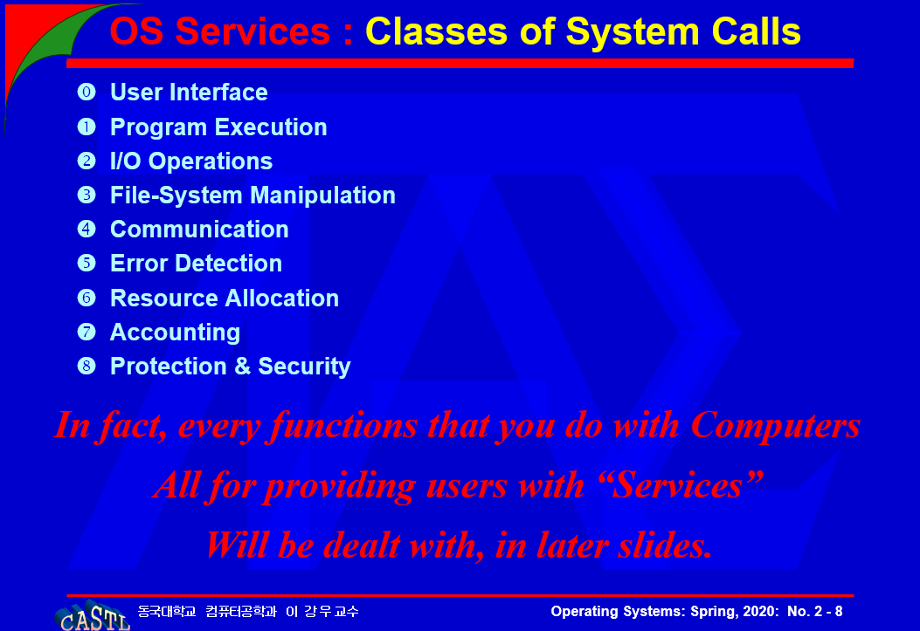
System Calls Introduction
❑ System Calls : Help users exploit OS services!
❍ Interface between users (processes) & Kernel
❍ Mostly written in HLL (C, C++), rarely in assembly language
➢ Examples : open(), close(), read(), write() …
➢ NB : fopen(), fclose(), scanf(), printf() are library functions
❑ Parameter Passing in System Calls
❍ Use special-purpose registers, or
❍ Use a block or table in main memory, or
❍ Use a stack in register or memory
❑ Class of System Calls ⇨ You will see Soon!
❍ Process(& Job or task) manipulation
❍ File manipulation
❍ Device manipulation
❍ Information maintenance
❍ Communications
➢ All can be classified in other ways such as ⇨
What are they?
동국대학교 컴퓨터공학과 이 강 우 교수

Slide 10

System Calls Example
❑ System Call Sequence
❍ To copy the contents of one file to another file
[ Libraries ]
printf(…);
scanf(…);
printf(…);
scanf(…);
fp1 = fopen(…,);
fp2 = fopen(…,);
for(…) {
fscanf(fp1,…);
fprintf(fp2, …);
}
fclose(fp2);
printf(…);
return(…);
[ System Calls ]
write(…);
read(…);
write(…);
read(…);
fd1 = open(…,);
fd2 = open(…,);
for(…) {
read(fd1,…);
write(fd2, …);
}
close(fd2);
write(…);
exit(…);
[1]
동국대학교 컴퓨터공학과 이 강 우 교수

Slide 11
System Calls Example : Standard IO API
[1]
동국대학교 컴퓨터공학과 이 강 우 교수

Slide 12

System Calls & Library Examples
Bodies of library functions
[1]
Bodies of System Calls
동국대학교 컴퓨터공학과 이 강 우 교수

Slide 13
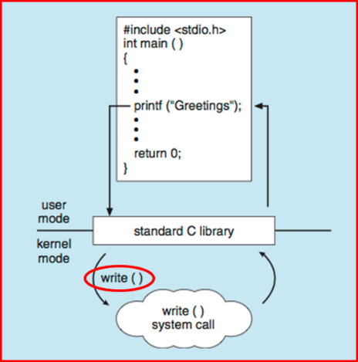

API vs. System Calls vs. OS Relationship
write()
return
value
fd
[1]
Starting address
of corresponding
System call
write()
Serial Number
for system calls
write()
[1]
동국대학교 컴퓨터공학과 이 강 우 교수

Slide 14
API vs. System Calls vs. OS Relationship
fd
Starting address
of corresponding
System call
Serial Number
for system calls
[1]
동국대학교 컴퓨터공학과 이 강 우 교수

Slide 15

Parameter Passing in System Calls
or a block of mem
or table in mem
or stack
[1]
동국대학교 컴퓨터공학과 이 강 우 교수

Slide 16
System Calls Implementation
❑ System Call Implementation
❍ Numbers are assigned to system calls in 1-to-1 manner
  ❍ System-call interface …
  ➢ maintains a table indexed according to these numbers
  ➢ each of table entries keeps starting address of “the” system call
  ➢ “invokes” intended system call in OS kernel, and
  ➢ returns status of the system call and any return values
❑ At the View Point of “User” …
❍ Needs to know nothing about how system call is implemented
  ❍ Just needs to obey API syntax and rules and
  to understand what OS will do for users
  ⇨ Most details are hidden from programmer by API
  ➢ Managed by run-time support library
  (set of functions built into libraries included with compiler)
동국대학교 컴퓨터공학과 이 강 우 교수

Slide 17
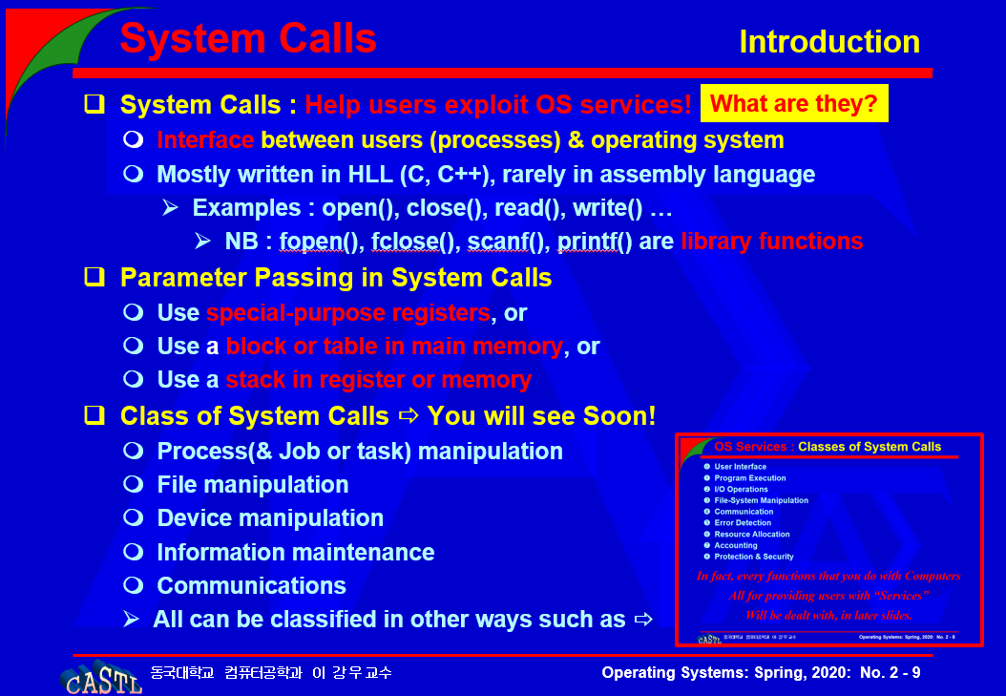
System Calls Services
❑ Process & Job Manipulation (or Control)
❍ 1. load, execute, end, abort
❍ 2. create & kill processes
❍ 3. get & set process attributes
❍ 4. wait for a certain time
❍ 5. wait & signal events
❍ 6. allocate & free(deallocate) memory
❑ File Manipulation
❍ 7. create & delete file
❍ 8. open & close file
❍ 9. read, write & reposition
❍ 10. get & set file attributes
동국대학교 컴퓨터공학과 이 강 우 교수

Slide 18
System Calls Services
❑ Device Manipulation
❍ 11. request & release device
❍ 12. read, write & reposition
❍ 13. get & set device attributes
❍ 14. logically attach & detach devices
❑ Information Maintenance
❍ 15. get & set time & date
❍ 16. get & set system data
❍ 17. get & set process, file & device attributes
❑ Communications
❍ 18. create & delete communication connection
❍ 19. send & receive messages
❍ 20. transfer status information
❍ 21. attach or detach remote devices
동국대학교 컴퓨터공학과 이 강 우 교수

Slide 19

System Calls Examples
[1]
동국대학교 컴퓨터공학과 이 강 우 교수

Slide 20
System Calls(Recall) Implementation
❑ System Call Implementation
❍ Numbers are assigned to system calls in 1-to-1 manner
  ❍ System-call interface …
  ➢ maintains a table indexed according to these numbers
  ➢ invokes intended system call in OS kernel, and
  ➢ returns status of the system call and any return values
❑ At the View Point of “User” …
❍ Needs to know nothing about how system call is implemented
  ❍ Just needs to obey API syntax and rules and
  to understand what OS will do for users
  ⇨ Most details are hidden from programmer by API
  ➢ Managed by run-time support library
  (set of functions built into libraries included with compiler)
동국대학교 컴퓨터공학과 이 강 우 교수

Slide 21
System Calls Homework #2
Present 2 system call examples for 21 kinds
that are enumerated in previous slides.
❍ Each system call “should be explained in detail” &
❍ present proper example codes for each of above
❑ Due by Next Thursday @ 1:29 pm
❑ Summit to e-class
안하영(******2033) 님이 모두에게: 오후 5:33
교수님 혹시 22번 슬라이드에 있는 이 숙제가 3번 과제일까요..? 원래 다음주 수요일까지 내는 숙제가 2번 과제(interrupt 정리)가 있었습니다!
답) 네, 맞습니다…ㅠㅠ 1주일 연기할까요?
→ OK, 1주일 연기하도록 하겠습니다. 5월 11일까지입니다!!
홍성빈(******1994) 님이 모두에게: 오후 5:35
교수님, 시스템 콜 과제에서 함수 예시는 윈도우 기준으로 조사하나요? 아니면 리눅스 기준으로 조사하나요?
답) LINUX 기준으로 해주세요. 이 책은 물론이고, 여러분들이 접하게 되는 대두분의 운영체제 내용들은 LINUX를 예시로 하기때문에, 학업의 일관성을 위해서는 LINUX가 좋겠습니다.
동국대학교 컴퓨터공학과 이 강 우 교수

Slide 22
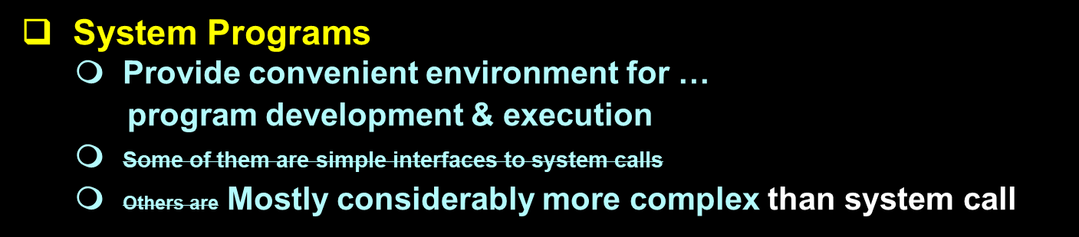
System Programs Introduction
User-1
User-2
User-3
User-n
compiler
assembler
editor
dbms
System (& application) Programs
Operating System
Computer hardware
[1]
[2]
동국대학교 컴퓨터공학과 이 강 우 교수

Slide 23
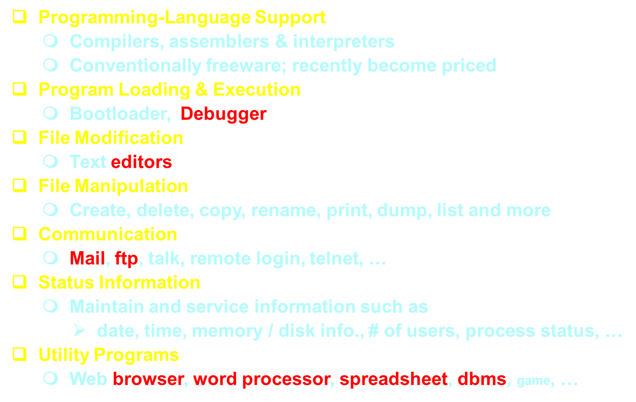
System Programs Functions
동국대학교 컴퓨터공학과 이 강 우 교수

Slide 24
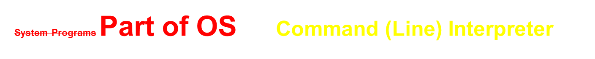
❑ Interpretation Method-1 (GUI)
❍ Interpreter itself contains subroutines’ codes to execute commands
❍ The size of interpreter depends on the number of commands
❑ Interpretation Method-2 (UNIX / Linux)
❍ Command service codes are in separate files named w/ commands
❍ Interpreter loads proper file into memory & executes it
❖ Advantages
❍ The size of interpreter is small
❍ New commands can be easily added w/o changing interpreter
❖ Disadvantages
❍ Command service codes may not be resident in memory
➢ Results in slower command execution
❍ Clumsy parameter passing
❍ Users must understand the behavior of newly added commands
before using them
동국대학교 컴퓨터공학과 이 강 우 교수

Slide 25
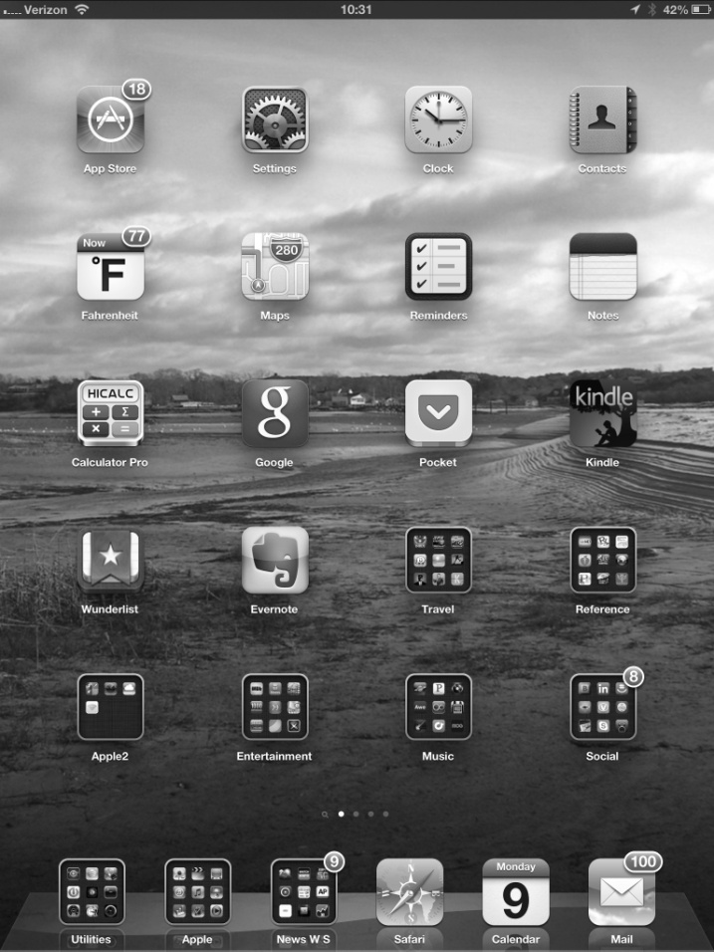

Touchscreen
[1]
Mac OS X GUI
[1]
동국대학교 컴퓨터공학과 이 강 우 교수

Slide 26

[1]
Bourne Shell
동국대학교 컴퓨터공학과 이 강 우 교수

Slide 27
System Structure Introduction
Large System Development
❍ Large & complex system such as O/S must be engineered carefully
➢ Actually, NOT Solvable
❖ Typical Approach
❶ Breakdown the problem into small pieces called modules
❷ Code for each module w/ (inputs), outputs & functions
❸ Organize modules into one large & complex system
❑ Goal of this chapter
To discuss the way that the O/S components are
interconnected & melted into a kernel
Take SW Engineering Course
to learn…
ways to design, implement & build large SW systems
동국대학교 컴퓨터공학과 이 강 우 교수

Slide 28

System Structure Simple Structure
Simple Structure
❍ Many commercial O/S do not have well-defined structure
➢ Such systems are those that started as small, simple & limited
systems. Then, grew beyond their original scope.
❖ Example: MS-DOS
❍ Interfaces & functionalities are not well separated
➢ User programs can access basic I/O routines
❍ Target was Intel 8088 that does not provide …
➢ dual mode, hardware protection
❍ As time goes by, H/W gets more complex
❍ Later MS-DOS gets large, but still unstructured
❖ Another example is original UNIX
[1]
동국대학교 컴퓨터공학과 이 강 우 교수

Slide 29
System Structure Kernel (of UNIX)
Everything below system call interface & above physical hardware
Users / Programmers
System Programs:
Shells &
Commands Compilers & interpreters
System libraries
User &
Programmer
interface
System call interface to the kernel
Signals terminal
Handling
Character I/O system
Terminal drivers
File system
Swapping block I/O
system
Disk & tape drivers
CPU scheduling
Page replacement
Demand paging
Virtual memory
Kernel
Kernel interface to the hardware
Terminal controllers
for
Terminals
Device controllers
for
Disks & Tapes
Memory controllers
for
Physical Memory
Hardware
[1]
동국대학교 컴퓨터공학과 이 강 우 교수

Slide 30
System Structure Today’s Kernel
[2]
동국대학교 컴퓨터공학과 이 강 우 교수

Slide 31
System Structure Kernel
Process Management and Scheduling
❍ Process Management
➢ Process creation and deletion, etc.
➢ Resource allocation and deallocation to processes
❍ Process Scheduling
➢ Ex: Preemptive Priority-based Time-sharing with Aging
❖ Inter-Process Communication
❍ IPC Mechanisms :
➢ Message queue, Shared memory, Semaphore, etc.
Memory Management and Virtual Addressing
❍ Use of Virtual Address
❍ Page Allocation and Deallocation
❍ Memory Mapping
동국대학교 컴퓨터공학과 이 강 우 교수

Slide 32
System Structure Kernel(Cont’d)
File System
❍ Management of files and storage space
❍ Regard all devices as files in UNIX/Linux
Modularized Device Drivers
❍ Provision of device files for generic peripherals
❍ For other devices, modularized device drivers
Networking
❍ Support of various communication protocols
➢ TCP/IP, UDP, etc.
동국대학교 컴퓨터공학과 이 강 우 교수

Slide 33
System Structure Layered Approach
Basics
❍ New UNIX versions are designed to use more advanced hardware
❍ Provided proper h/w, O/S can be broken into smaller pieces
➢ O/S retains much greater control over computers / applications
❍ Implementors have more freedom to make changes to O/S
Modularization: Layered Approach
❍ Among many ways, most appealing is the “layered approach”
❖ Methodology:
❍ Break O/S into number many layers (levels)
❍ Each layer is built on top of lower layers
➢ Bottom layer (layer 0) is the hardware
➢ Highest layer (layer N) is the user interface
Layer M
Layer
M-1
[1]
New operations
Hidden operations
Existing operations
동국대학교 컴퓨터공학과 이 강 우 교수

Slide 34
System Structure Layered Approach
Layered Approach
❍ Layers are selected such that each layer uses operations & services
of only its lower layers
❍ A layer needs not to know how operations in lower layers are made
➢ It only needs to know what these operations do
➢ A layer hides data structures, operations & h/w from higher layers
Advantages
❍ Simple debugging & system verification
Example:
Level 6: User programs
Level 5: Device drivers & schedulers
Level 4: Virtual memory
Level 3: I/O channel
Level 2: CPU scheduling
Level 1: instruction interpreter
Level 0: hardware
[1]
동국대학교 컴퓨터공학과 이 강 우 교수

Slide 35
System Structure Layered Approach
Difficulties
❍ Defining the hierarchy of layers
❍ Defining functions to be contained within a certain layer
❍ More difficult than thought
Today’s Trend
❍ Keep fewer layers with more functionalities in each layer
➢ Maintain most of advantages of modularization
➢ Avoid difficult problems of layer definition & interaction
❖ Examples:
❶ OS/2
➢ Descendent of MS-DOS
➢ More powerful w/ additional modules designed in layers
❷ Windows NT
➢ First version is very layer-oriented & suffered from low speed
➢ In V. 4.0, layers are moved from user space to kernel space
& inner layers are closely integrated
동국대학교 컴퓨터공학과 이 강 우 교수

Slide 36
S/s Design & Implementation Introduction
We will discuss problems of designing & implementing a system
Of course, there are no complete solutions; but suggested approaches
Generation
Implementation
Impl. mechanisms
Working policies
Take
SW Engineering
Course
동국대학교 컴퓨터공학과 이 강 우 교수

Slide 37
S/s Design & Implementation Design Goals
Design Goals
❍ The first problem in design problems:
➢ to define design goals & system specifications
❖ User Goals:
❍ Convenient, easy, reliable, safe & fast
❖ (Computer) System Goals:
❍ Easy to design, implement, debug, & maintain
❍ Flexible, reliable, error-free, efficient
 These are all vague
 No general solutions for defining goals or requirements for an O/S
 Only principles can be suggested ⇨ Software engineering
동국대학교 컴퓨터공학과 이 강 우 교수

Slide 38
S/s Design & Impl. Mechanisms & Policies
Definitions
❖ Mechanisms:
❍ “How” to do something
❖ Policies:
❍ “What” will be done
❖ Example: CPU Protection
❍ Mechanism: timer
❍ Policy: allow 0.5 sec per process in round-robin manner
Discussion
❍ Policies are likely to change from place/time to place/time
❍ Policy change may require a change in underlying mechanism
 Importantly, separate policy from mechanism
 Then, we can minimize the chance of changing mechanisms
although the policies are changed
동국대학교 컴퓨터공학과 이 강 우 교수

Slide 39
S/s Design & Impl. Implementation
Languages
❍ Main body in C
❍ System programs in C / C++ plus PERL, Python, Script
❍ Lowest levels in assembly language
Disadvantages of Using High-Level Languages
❶ Reduced speed
❷ Increased storage requirement
Advantages of Using High-Level Languages
❶ Fast coding & Compact codes
❷ Easy to understand & debug
❸ Improved compilers will improve generated code w/o changing code
 Disadvantage ❷ can be minimized
❹ Easy to port
➢ MS-DOS in assembler code is available only on Intel’s CPU
➢ UNIX is available on Intel 80x86, Motorola 680x0, SPARC, MIPS Rx000
동국대학교 컴퓨터공학과 이 강 우 교수

Slide 40
S/s Design & Impl. Speed Issues
O/S coded in high-level languages are thought to be slow. But ….
❑ Advanced Compiler Techniques
❍ Can generate very good/fast-to-run codes
➢ Very complex program analysis &
➢ Sophisticated optimizations
❑ Advanced Processor Techniques
❍ Can get advantages of advanced compiler techniques
➢ CPUs with deep pipeline &
➢ CPUs with multiple functional units
❑ Software Performance Issues
❍ Better performance is more likely to be the result of
better data structures / algorithms than of excellent assembly code
❍ Even if O/S is huge, only small part of code is critical to high performance
➢ Memory manager & CPU scheduler
❍ Once developed, O/S can be identified its performance bottleneck
➢ Those portion can be replaced with assembler code, at last
동국대학교 컴퓨터공학과 이 강 우 교수

Slide 41
System Generation Introduction
We want implemented O/S can be used in general system models
of diverse class of machines with variety of peripherals
❑ SYSGEN (Process of System Generation)
❍ O/S programs are usually distributed on disks or tapes
❖ SYSGEN Program earns system configuration information by …
❶ Reading from a file
❷ Asking to the operator
❸ Probes the hardware directly
❖ Typical System Configuration Factors
❶ CPU architecture model & extended options
❷ Available main memory
❸ Available attached devices
❹ O/S options & parameters that user/operator likes to have
동국대학교 컴퓨터공학과 이 강 우 교수

Slide 42
System Generation Introduction
❑ Works of SYSGEN after Getting System Info.
❖ System configuration information …
❶ Can be used to modify O/S source code
➢ O/S need to be compiled and run again
❷ Can cause creation of tables & selection of modules/libraries
➢ This is the case when O/S is only slightly tailored
➢ These modules/libraries are linked to form generated O/S
➢ No need to recompile ⇨ system generation is faster
➢ But, might result in more generality than actually needed
❸ Can cause the whole system to be completely table-driven
동국대학교 컴퓨터공학과 이 강 우 교수

Slide 43
References
[1] Operating System : Concepts 9th Ed. – By A. Silberschatz, et al.
[2] https://www.slideshare.net/UbuntuKorea/2010y01m30d
동국대학교 컴퓨터공학과 이 강 우 교수

Slide 44

Any Question?
동국대학교 컴퓨터공학과 이 강 우 교수

